Slide 1
Black Friday Data
By Ahmed Khan, Mudit Kumar, Vanisre Jaiswal

Slide 2
Problem Selection
Black Friday is one of the biggest sales events in America
Retail stores should be able to plan in advance what products sell the best
Knowing what items are needed will help boost sales, while minimizing cost of stocking unnecessary products
Trying to predict the amount of purchase based on other factors using various statistical methods

Slide 3
Data Collection
Data is a sample of transactions made in a store during Black Friday
537,577 observations containing 12 features
Data found here: https://www.kaggle.com/mehdidag/black-friday
Categorized by letter: Product names withheld

Slide 4
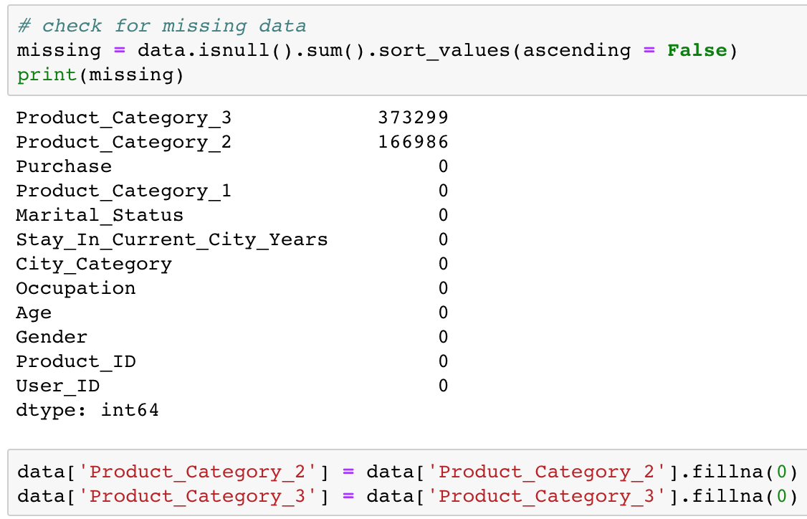
Data Preparation
Only 2 attributes contain missing data
Safe to replace these with 0 since it implies it does not describe the product

Slide 5
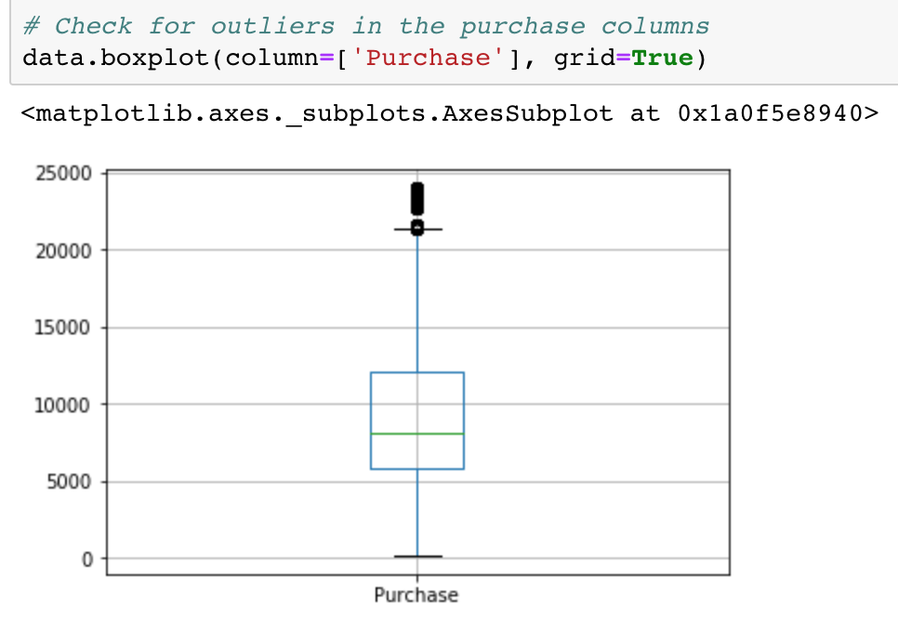
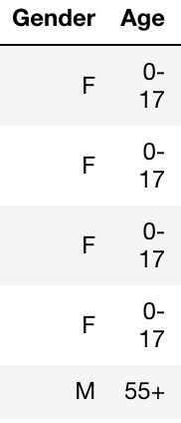
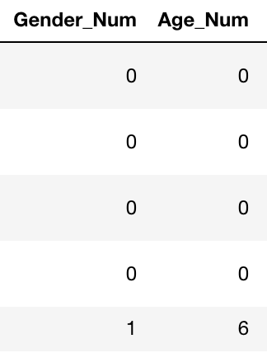
Data Preparation Cont.
Converted categorical columns to numerical representation
Outliers

Slide 6
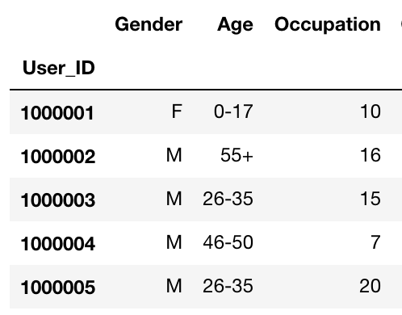
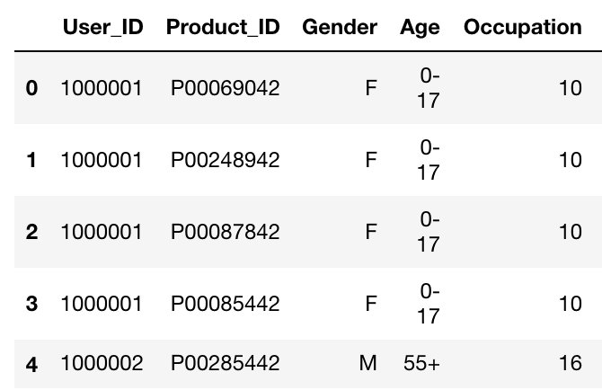
Data Preparation Cont.
Combined repeating values

Slide 7
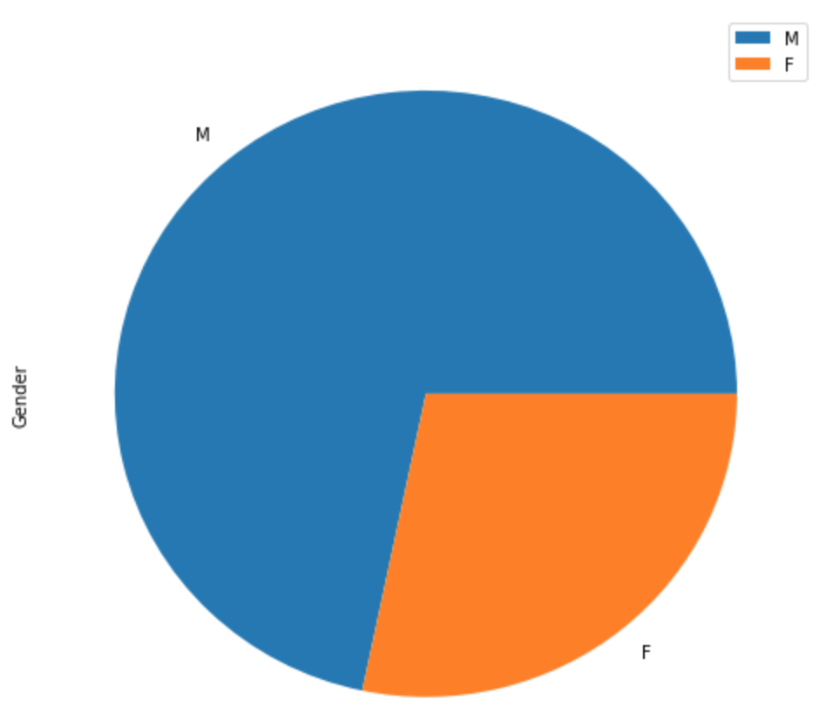
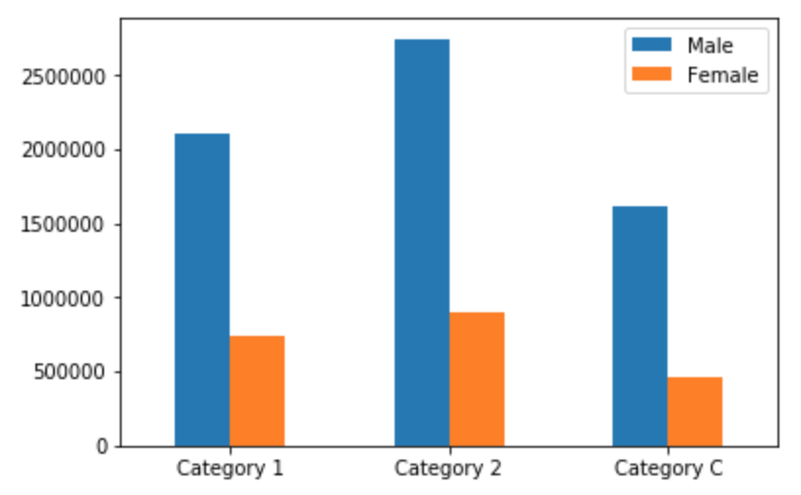
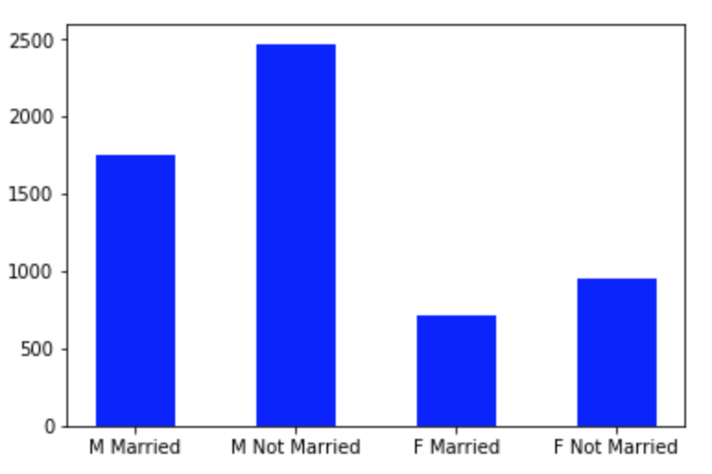
Exploratory Data Analysis - Gender

Slide 8
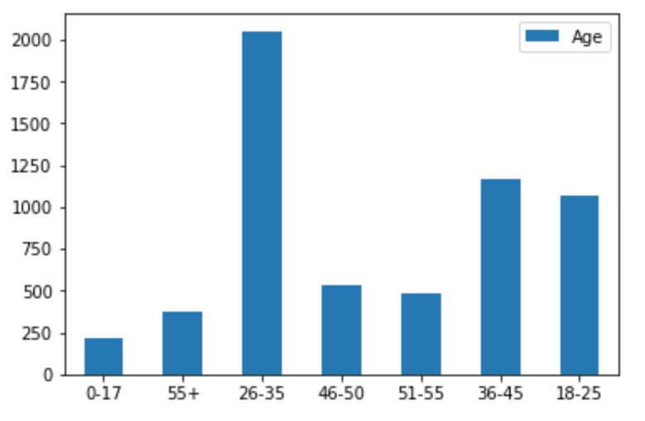
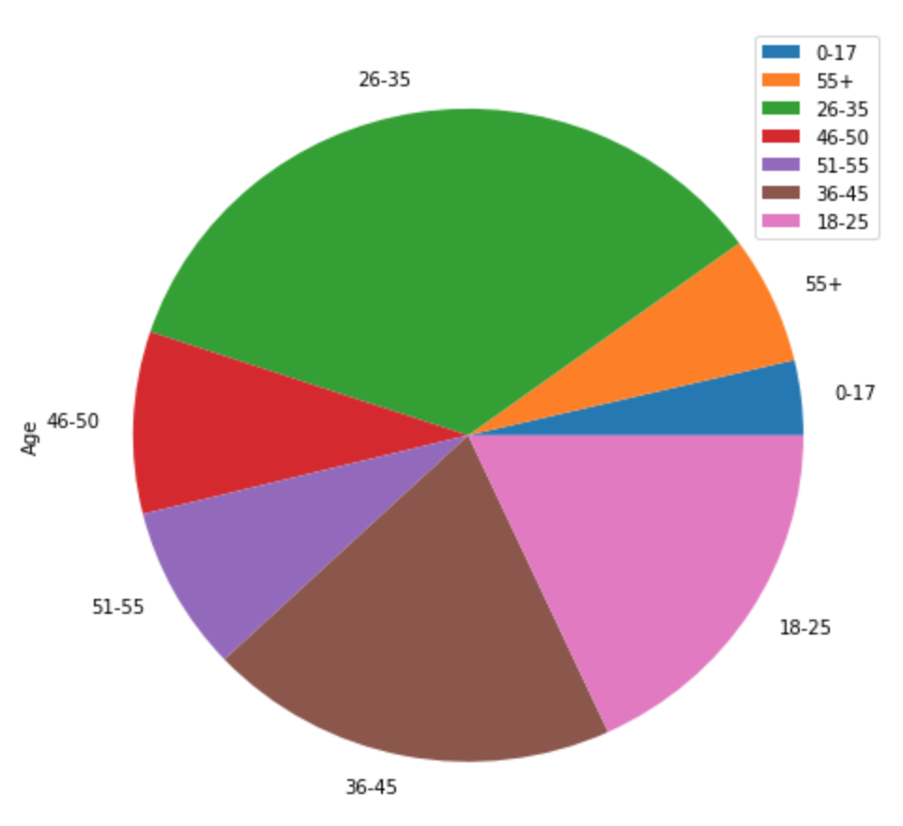
Exploratory Data Analysis - Age

Slide 9
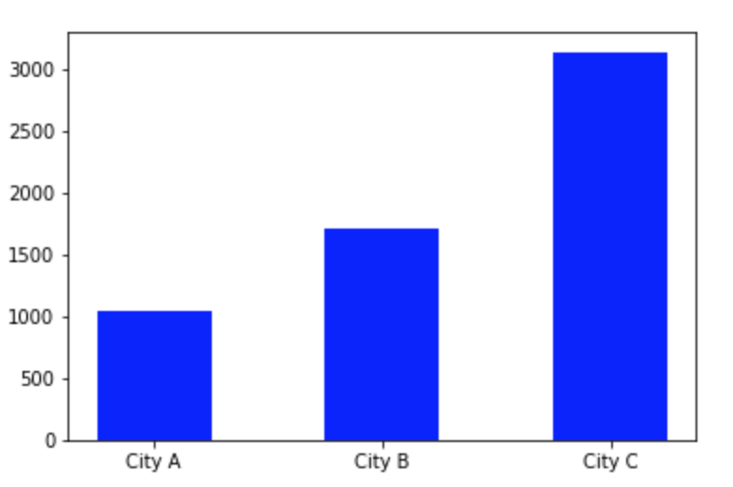
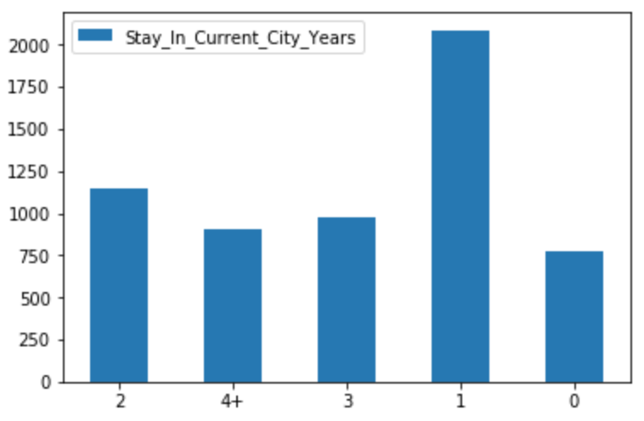
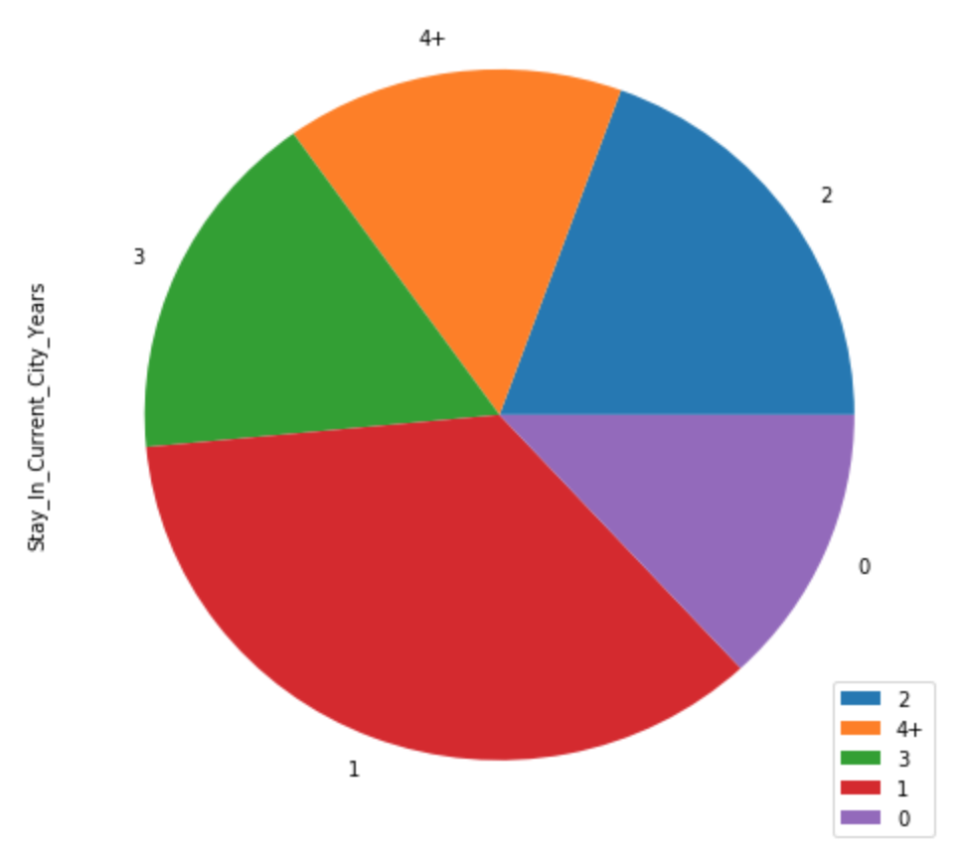
Exploratory Data Analysis - Residence

Slide 10
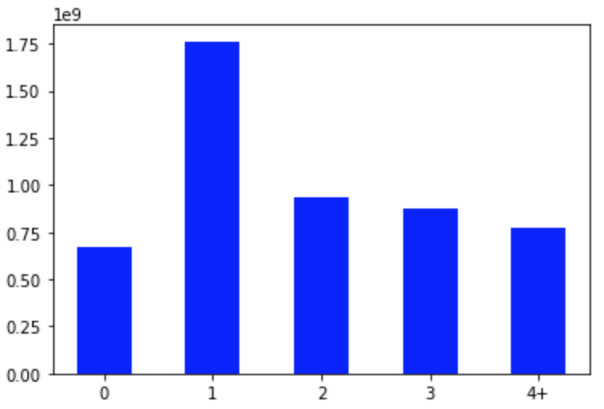
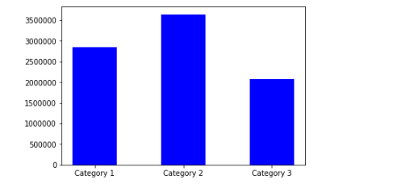
Exploratory Data Analysis - Sales
$1,763,243,917

